Slide 1





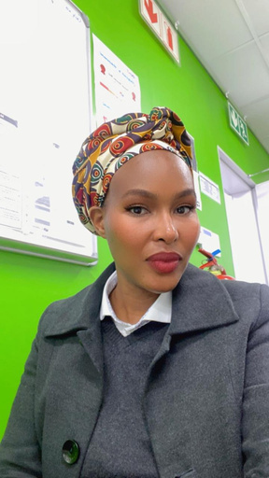
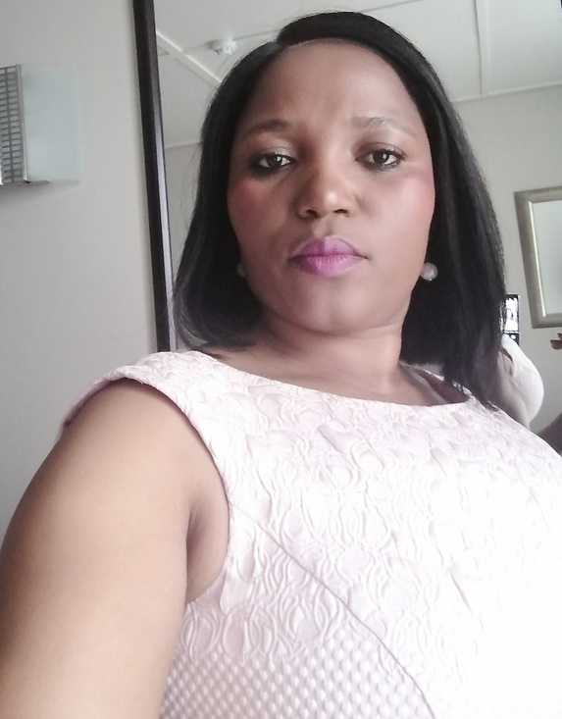

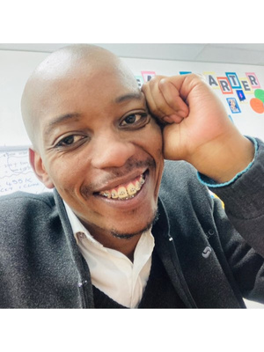
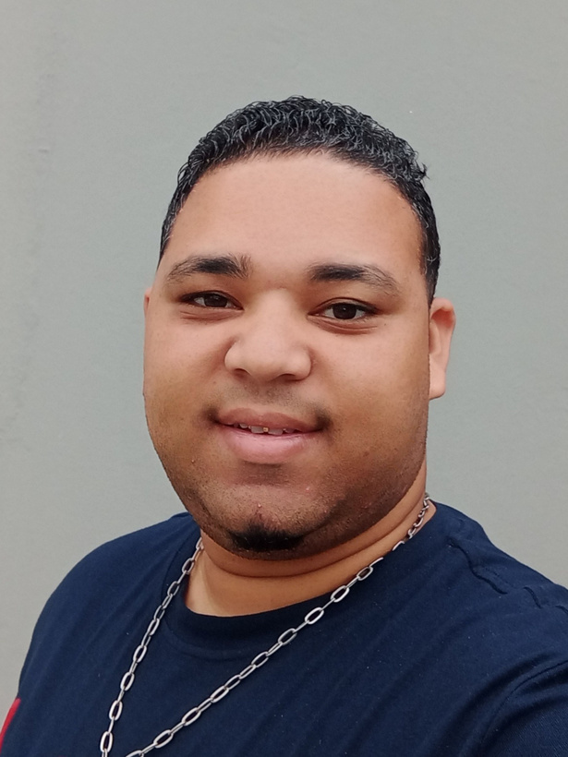
DESIGN TEAM
Meet the fantastic 5....
We are a team of talented young aspiring designers and developers from the Capitec IMI learnership.
BERVELY TEFFU
CIKIZWA MENE
JASON BANGIE
MTHUNZI RADA
LEE HILDEBRANDT
Trainee Programmer
Trainee Programmer
Trainee Programmer
Trainee Programmer
Trainee Programmer

Slide 2

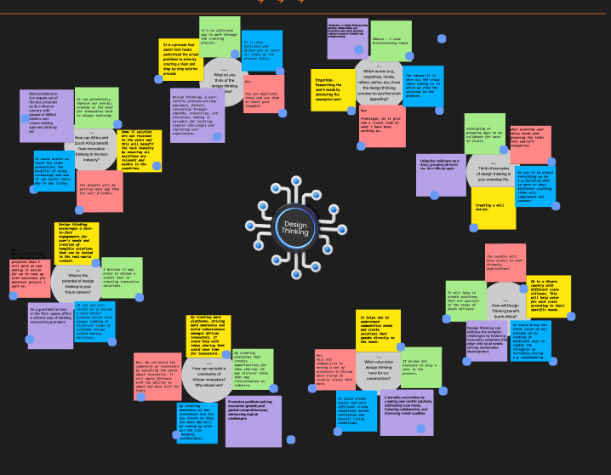




OUR DESIGN THINKING JOURNEY
ABOUT
Using the below design think steps our team was tasked creating a fintech solution that could solve a specific client’s problem.
EMPATHIZE
DEFINE
IDEATE
PROTOTYPE
TEST

Slide 3

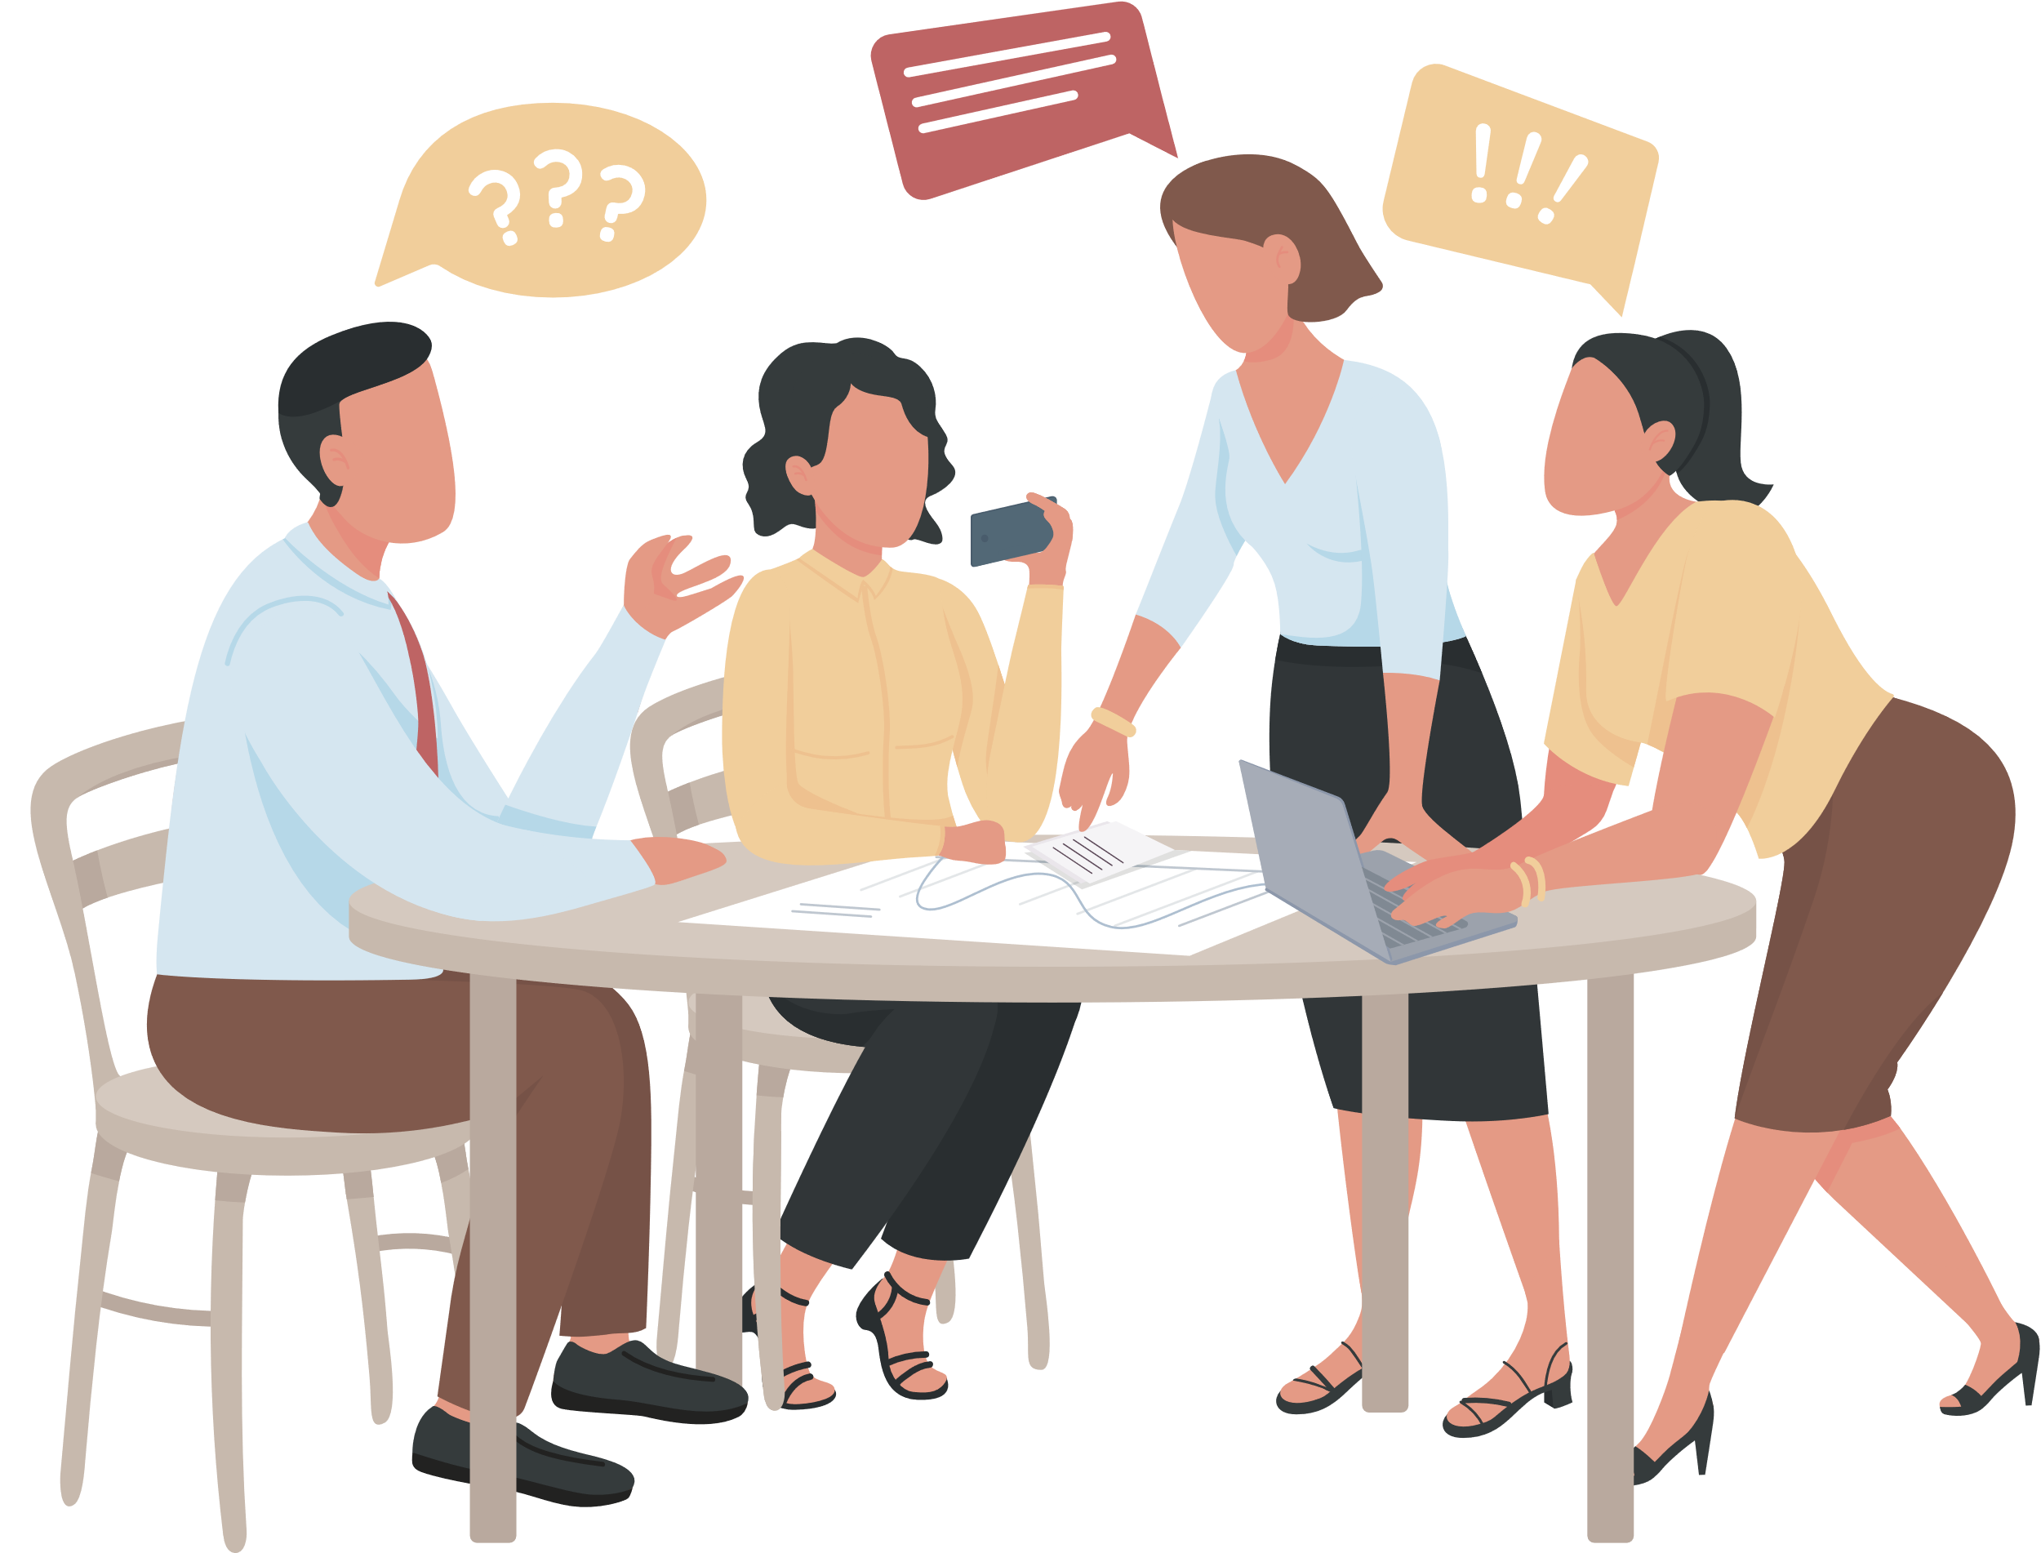

WHO DO WE DESIGN FOR?
TRAVELLER
WHO
NEEDS A TICKET SERVICE
ENTREPRENEUR
FOREIGNER
WHO
WHO
IS LOOKING FOR INVESTORS
NEEDS TO KNOW THE CURRENT EXCHANGE RATES
GUARDIAN / PARENT
WHO
NEEDS ALL IN ONE FAMILY BANKING SOLUTION

Slide 4


Persona
MEET ABONGILE..
MY NAME IS ABONGILE AND I AM PROUD MOTHER LOOKING FOR AN ALL-IN-ONE FAMILY BANKING SOLUTION.
More Info

Slide 5

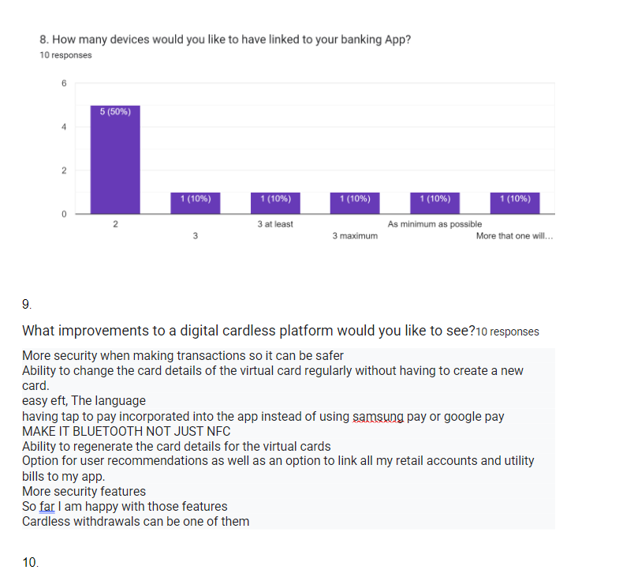

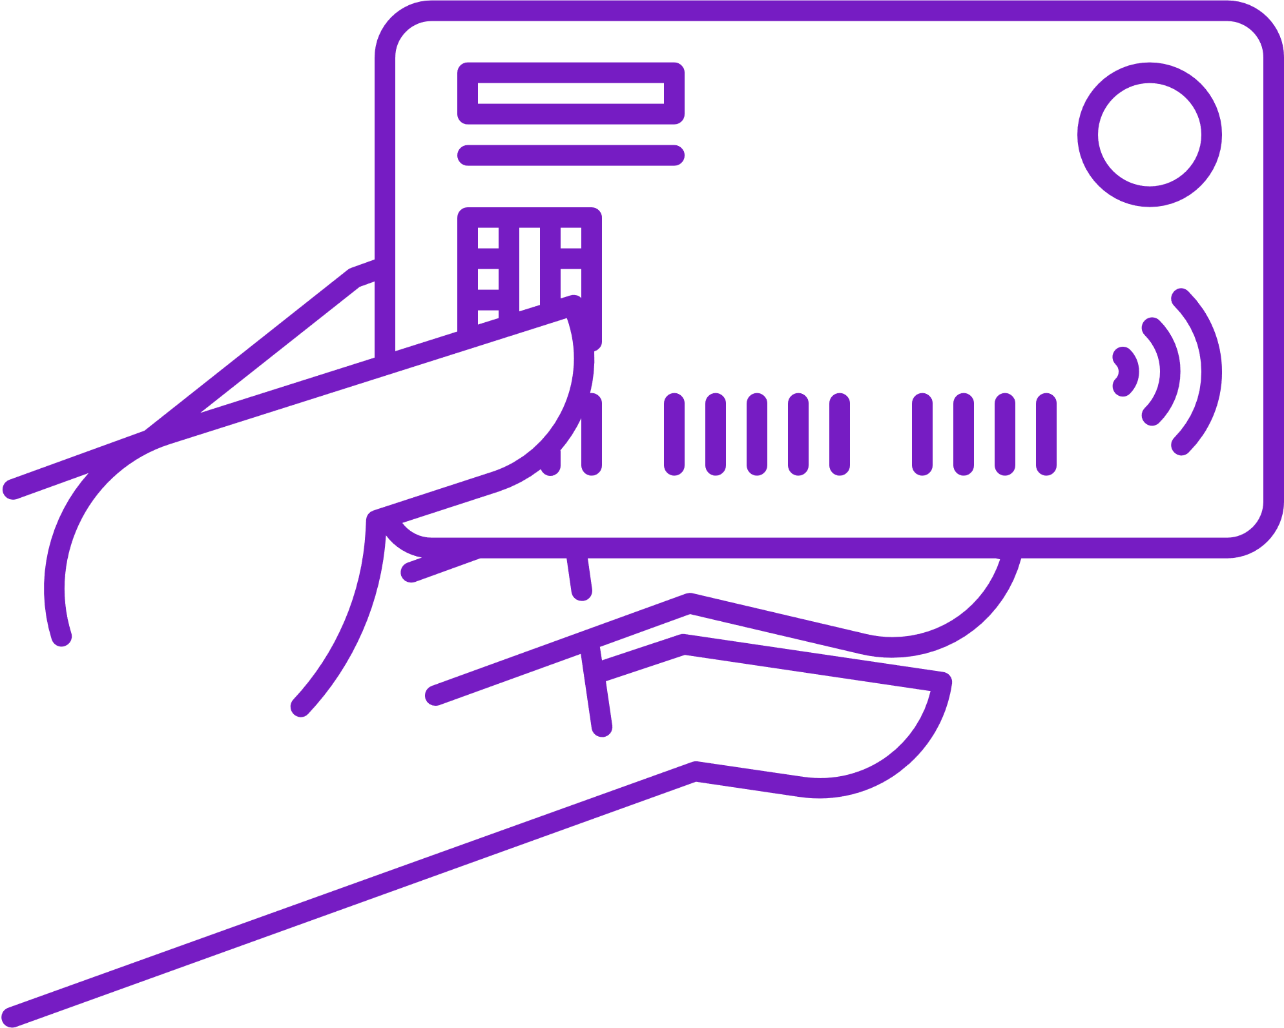
SURVEY QUESTIONNAIRE
Description...
We sent out a questionnaire to Guardians to gain some incite into what they looking for in a fintech app
Responses
Preferred cardless
10.00
70.00%

Slide 6
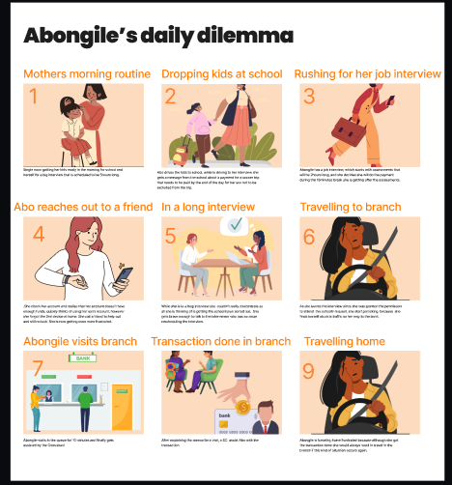
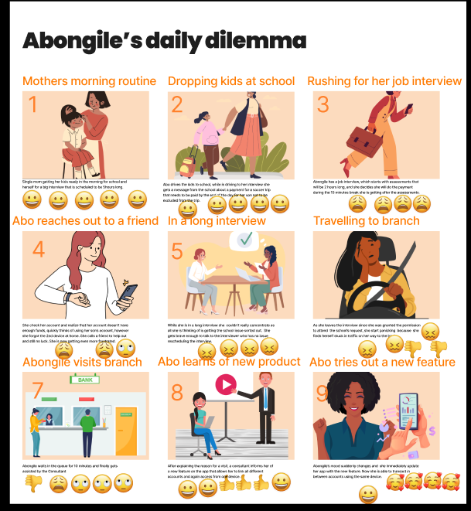
USER JOURNEY

Slide 7
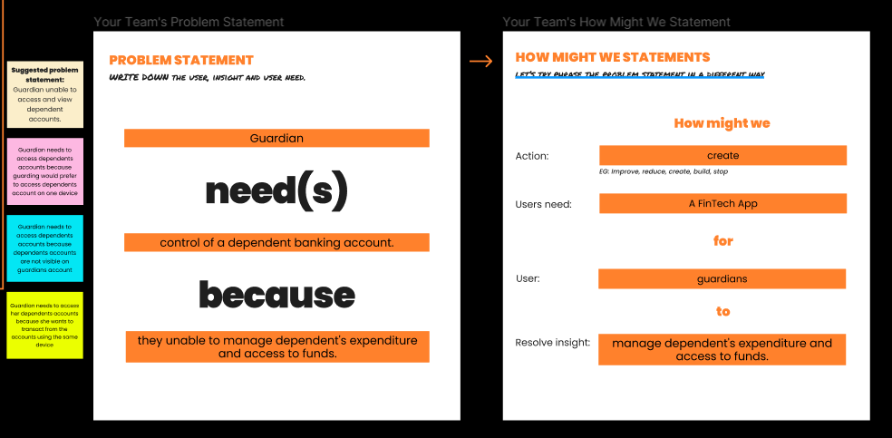
Apps
PROBLEM STATEMENT

Slide 8
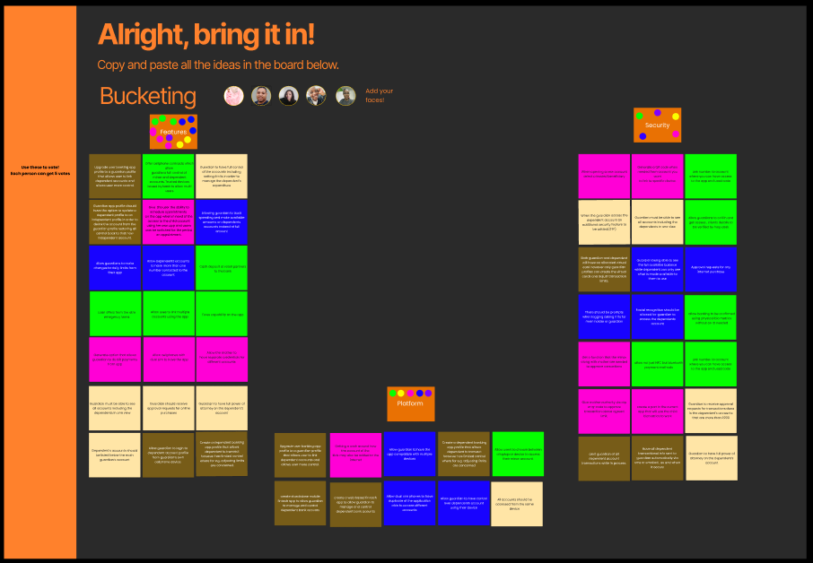
BRAINSTORM
Description...
We catalogued all relevant ideas and selected those that best suited our persona.

Slide 9

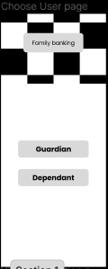
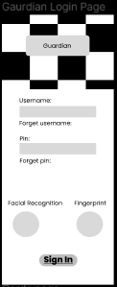
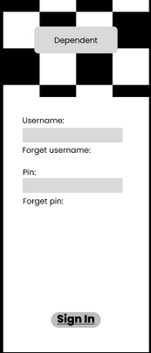
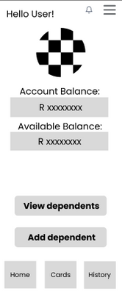

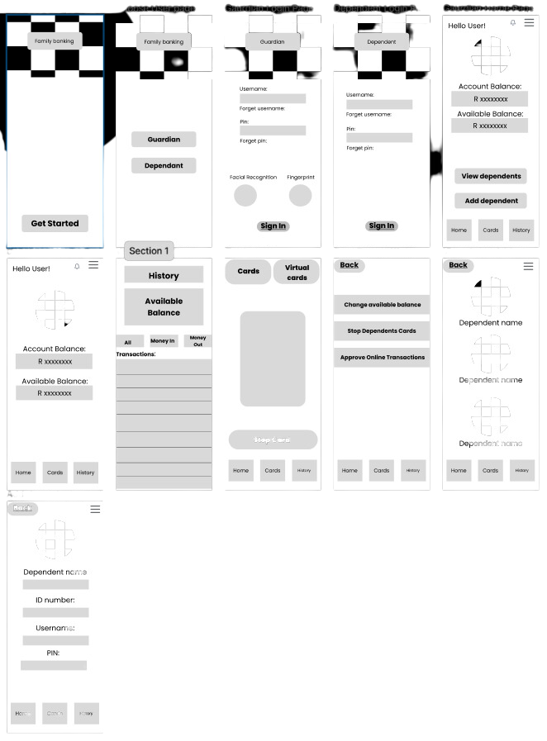
OUR WIREFRAME

Slide 10
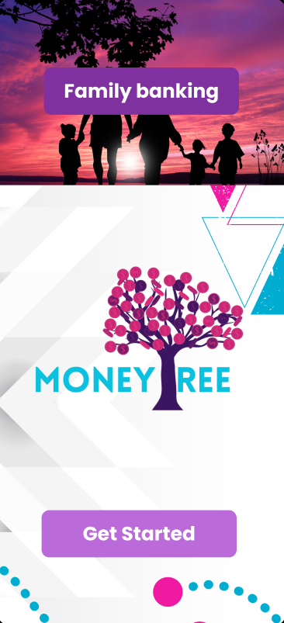
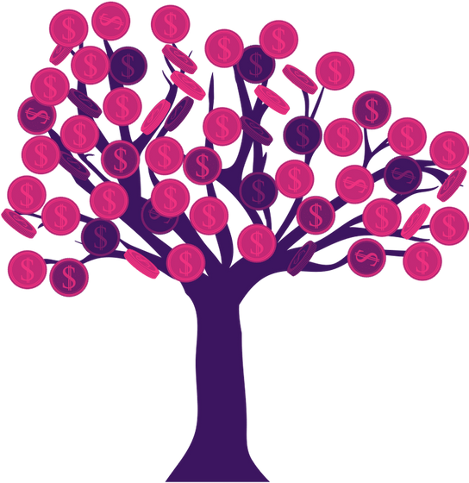
MONEY
REE
PRESENTATION
Gurdian digital money management tool

Slide 11

CONCLUSION
HIGHS
LOWS
LEARNINGS
Seeing the actual complete prototype.
Presentation design.
Working on the prototype.
Getting to work on figma, Seeing the prototype presentation.
Trying to figure out figma on day one.
Coming up with ridiculous 10 ideas.
Figuring figma out
First day using figma the more days we spent on figma the more competent we became.
Working as a team creates more ideas more efficiently.
Collaboration and how design thinking can be used as a daily tool for life.

